Slide 1

RAILWAY LEVEL CROSSING GATE CONTROL BY ANDROID APPLICATION
GURUNANAK INSTITUTE OF TECHNOLOGY
Ch K Chaitanya 17831A0414
ECE-4A.
K Raja 17831A0435
ECE-4A.
K Sai Teja
17831A0436
ECE-4A.
Under the guidance of
Mr S Sivaiah
Assistant Professor
ECE Department,GNIT

Slide 2
CONTENTS:
ABSTRACT
THE PRESENT SCENARIO
PROPOSED SYSTEM
BLOCK DIAGRAM
HARDWARE COMPONENTS
SOFTWARE COMPONENTS
CONCLUSION

Slide 3
ABSTRACT:
The Project is designed to achieve control over the railway level crossing gate through Android Application by the station master. Opening and closing of railway level crossing gate involves manpower, which could be often erroneous leading to accidents. The proposed system rules out the need of any human involvement at the railway level crossing. This system involves opening and closing of the level crossing gate with help of an Android Application Device.

Slide 4
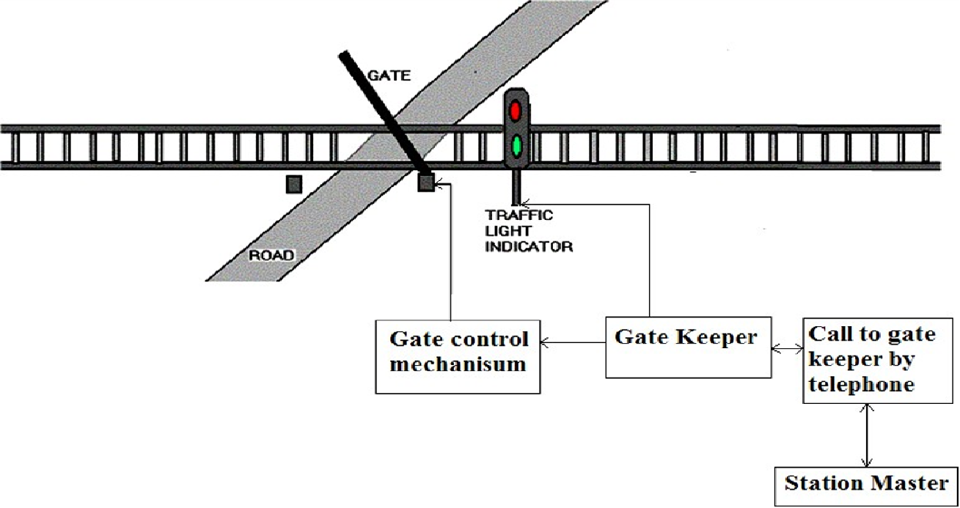
THE PRESENT SCENARIO:
The opening and closing of railway gate is traditionally operated through manual lever pulling method.
Rail road related accidents are more dangerous than other transportation accidents in terms of severity and death rate.

Slide 5
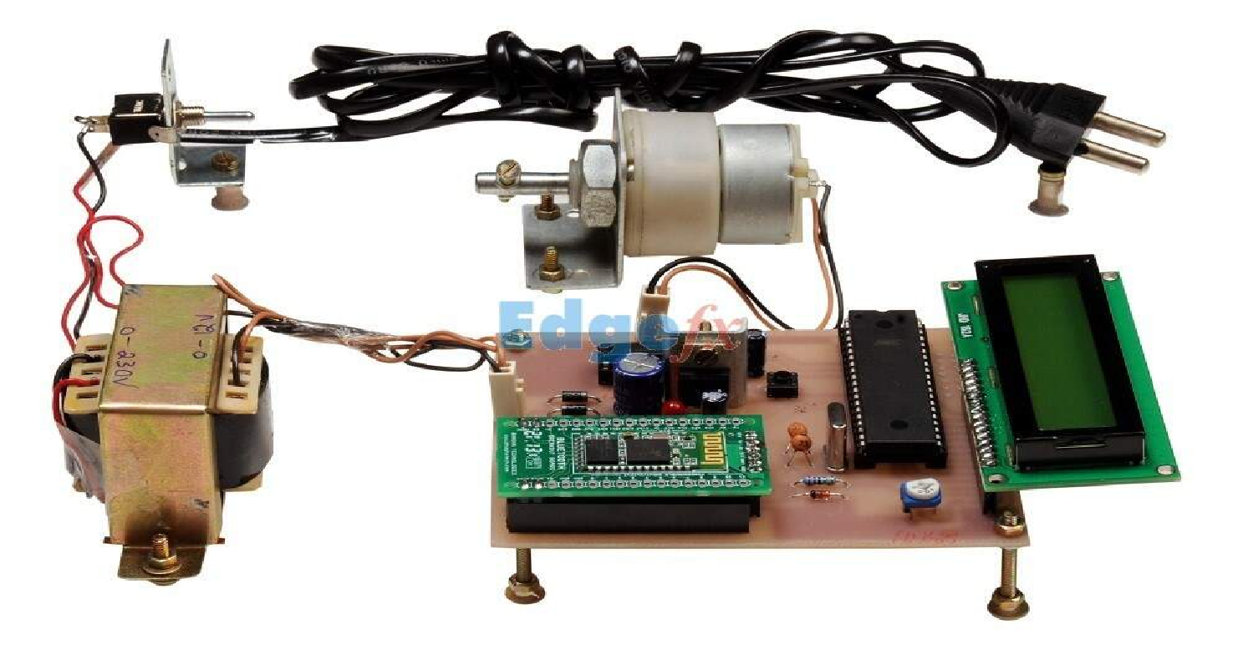
PROPOSED SYSTEM:
In this project a smartphone mobile is used which contain Android app connect to railway. This Bluetooth module sends data to microcontroller. This signal goes to DC motor. It works according to microcontroller. Whenever pin is set gate remains close and when pin reset becomes active, gate remains open.

Slide 6
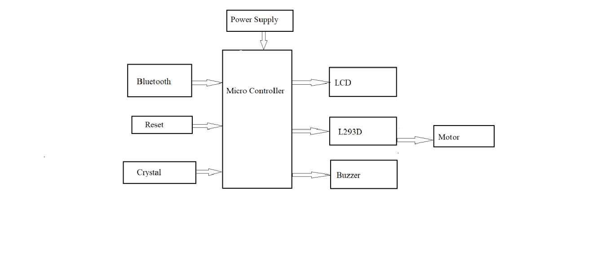
BLOCK DIAGRAM:

Slide 7
HARDWARE COMPONENTS:
AT89S52 Microcontroller
Bluetooth (HC-05)
Transformer (12V)
Voltage Regulator (7805 IC)
16X2 LCD (HD44780)
Driver Circuit (L293D)
DC Motor(12v,0.60amp,100rpm)
Buzzer

Slide 8
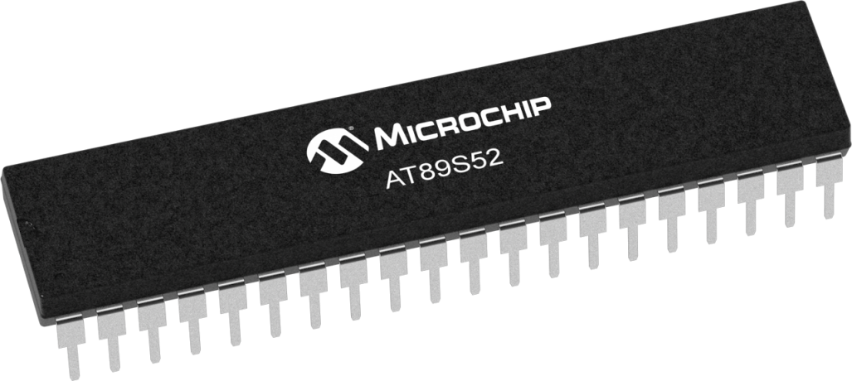
AT89S52 MICROCONTROLLER:
The Atmel AT89S52 is an 8052 based Full Static CMOS controller with Three-Level Program Memory Lock, 3 Timers/Counters, 8 Interrupts Sources, Watchdog Timer, 2 DPTRs,256 Bytes On-chip RAM.

Slide 9
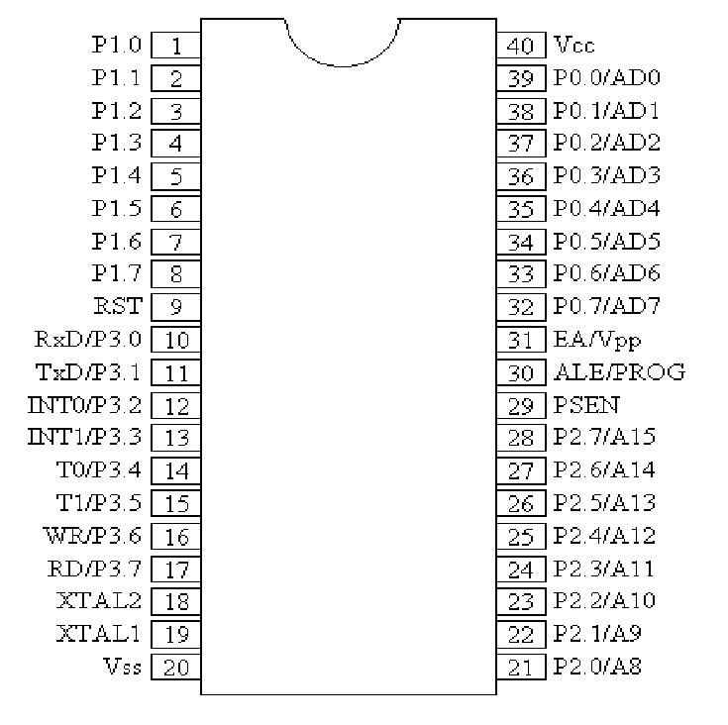
PIN DIAGRAM OF 8052:

Slide 10
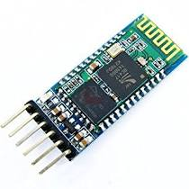
BLUETOOTH HC-05:
Bluetooth is a wireless technology standard for exchanging data over short distances from fixed and mobile devices and building personal area networks.

Slide 11
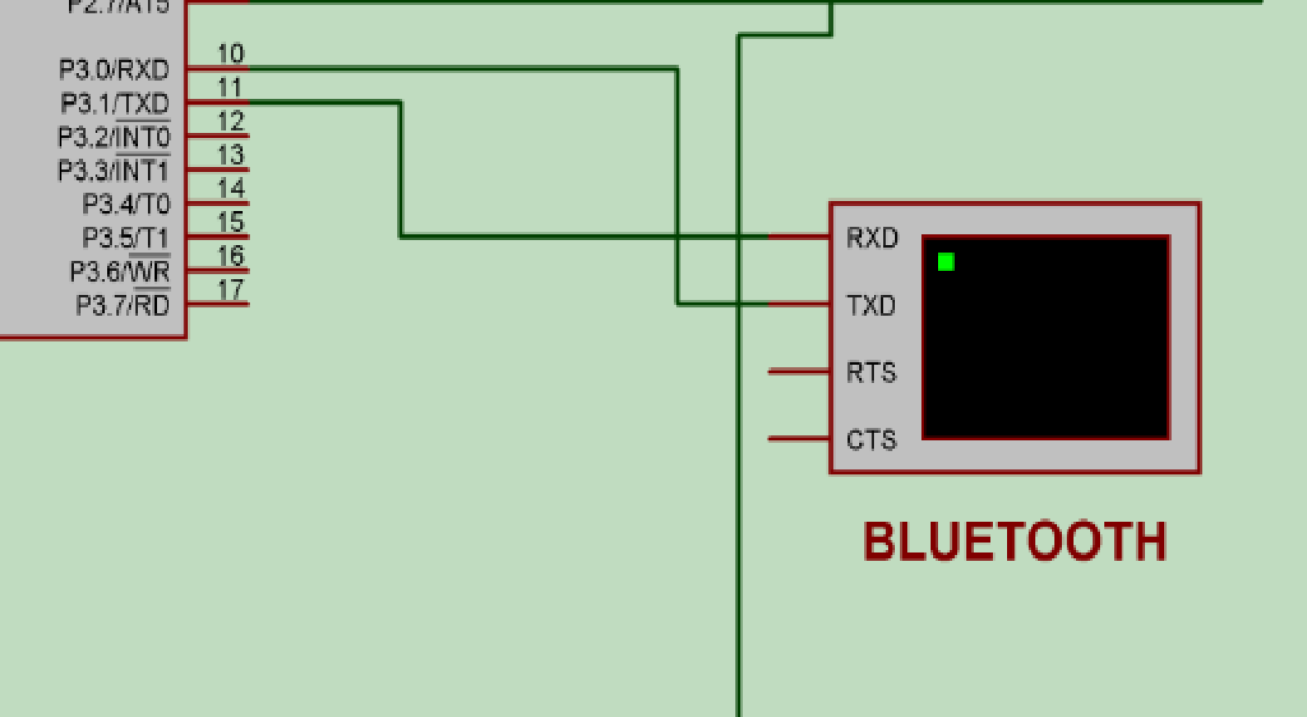
INTERFACE OF BLUETOOTH:

Slide 12
POWER SUPPLY:
The power supply section is the section which provide +5V for the components to work. IC LM7805 is used for providing a constant power of +5V.
A diode rectifier that provides a full-wave rectified voltage that is initially filtered by a simple capacitor filter to produce a dc voltage.

Slide 13
CIRCUIT DIAGRAM OF POWER SUPPLY:

Slide 14
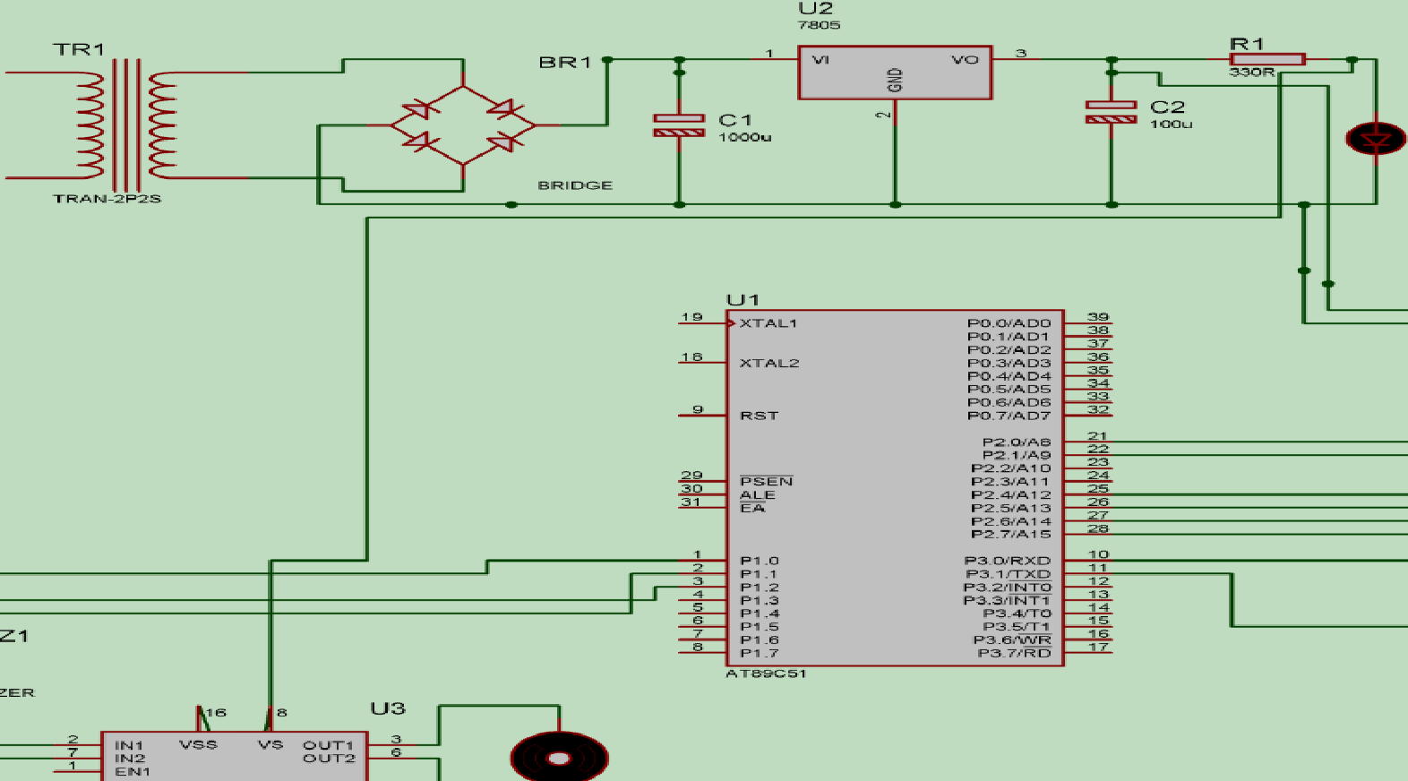
INTERFACE OF POWER SUPPLY:

Slide 15
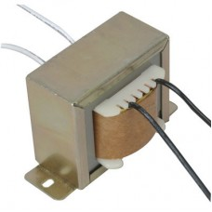
TRANSFORMER:
Transformers convert AC electricity from one voltage to another with little loss of power. Transformers work only with AC and this is one of the reasons which means electricity is AC.

Slide 16
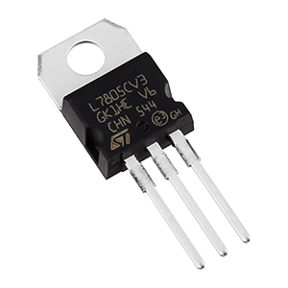
VOLTAGE REGULATOR (7805 IC):
7805 is a three terminal linear voltage regulator IC with a fixed output voltage of 5V which is useful in a wide range of applications.

Slide 17
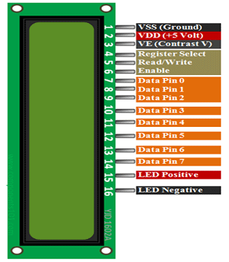
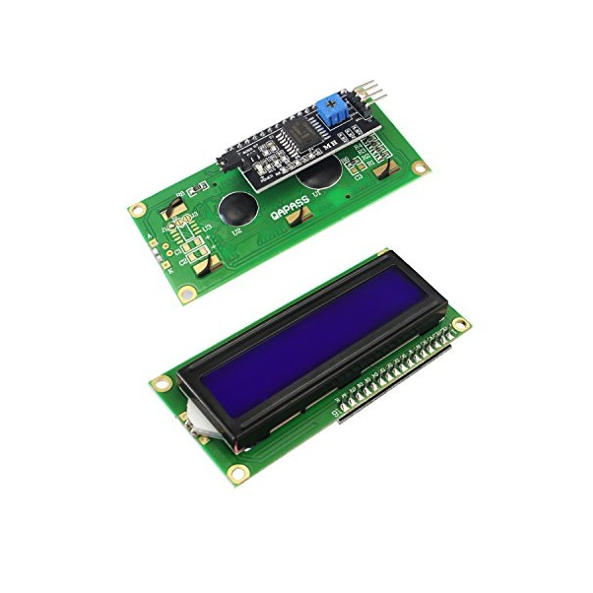
LIQUID CRYSTAL DISPLAY:
LCD screen is an electronic display module and find a wide range of applications
A 16x2 LCD display is very basic module and is very commonly used in various devices and circuits.

Slide 18
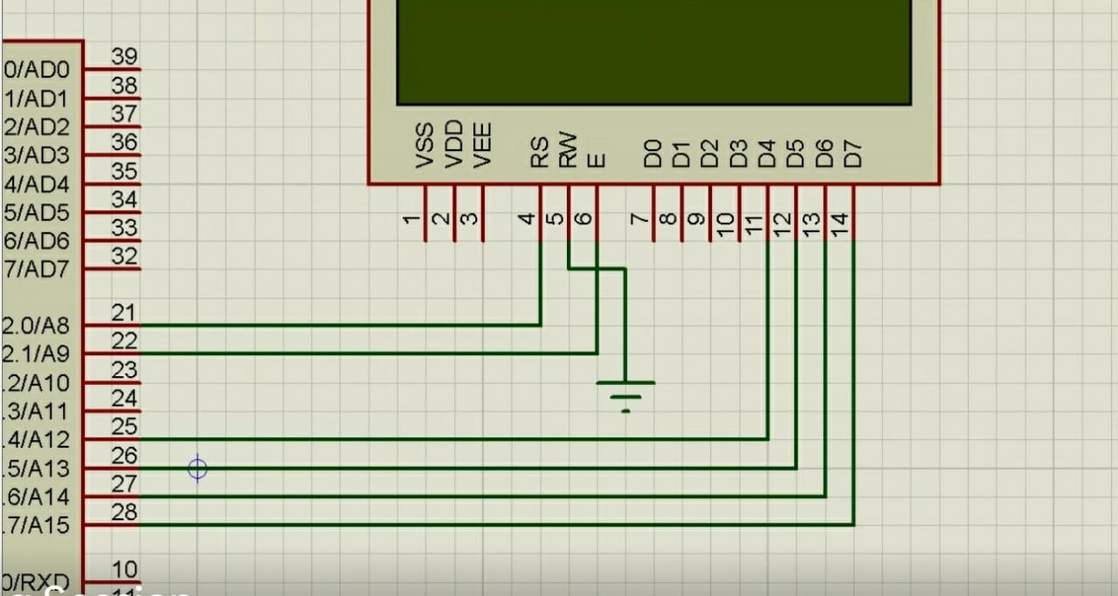
INTERFACE OF LCD DISPLAY:

Slide 19
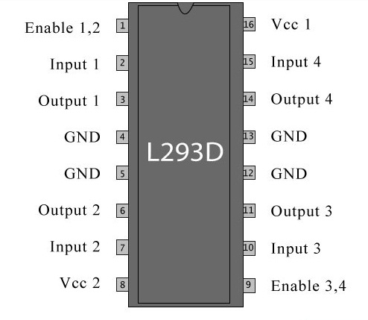
DRIVER CIRCUIT (L293D):
L293D IC generally comes as a standard 16-pin DIP (dual-in line package). This motor driver IC can simultaneously control two small motors in either direction; forward and reverse with just 4 microcontroller pins.

Slide 20
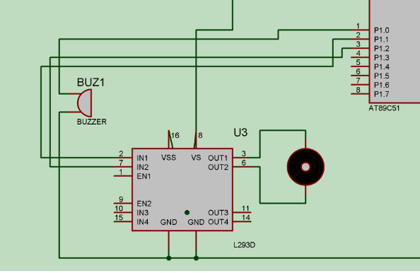
INTERFACE OF DRIVER CIRCUIT:

Slide 21
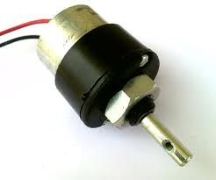
DC MOTOR(12v,0.60amp,100rpm):
A DC motor consists of two parts, a "Stator" which is the stationary part and a "Rotor" which is the rotating part.

Slide 22
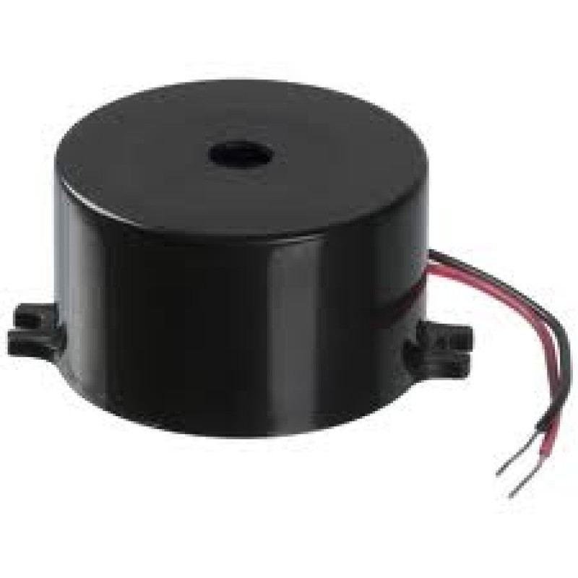
BUZZER:
A buzzer or beeper is a signaling device, usually electronic, typically used in automobiles, house hold appliances such as a microwave oven, or game shows.

Slide 23
SOFTWARE COMPONENTS:
Keil Compiler
Embedded C

Slide 24
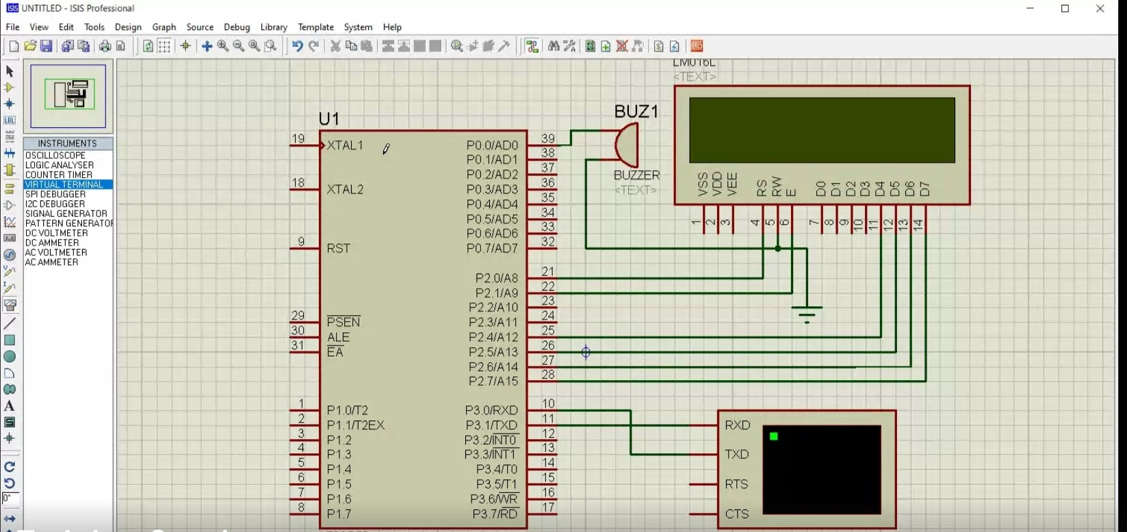

Slide 25
CONCLUSION:
Avoid manual errors and provides ultimate safety to road users.
Gatekeepers are not necessary and Automatic operation of the gate through the motor.
The mechanism works on a simple principle.

Slide 26
Thank you

